Slide 1
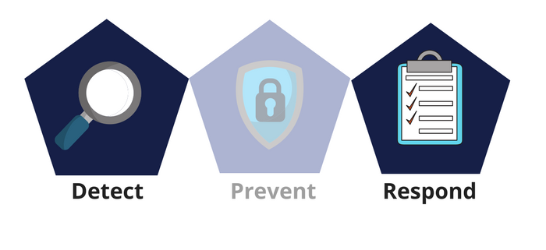



Network Security
Class X
lab 30

Slide 2

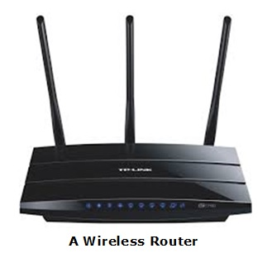
Wireless Network
two or more devices connected with each other via radio waves within a limited space range

Slide 3
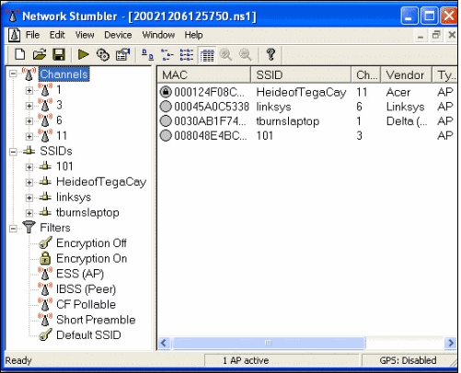
Wireless Hacking Tools
Kismet
NetStumbler

Slide 4
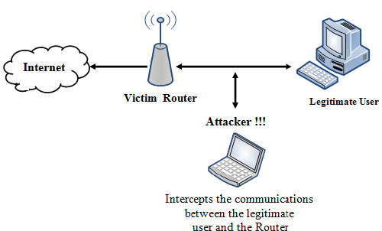
Wired Equivalent Privacy
(WEP) is a security protocol that was invented to secure wireless networks and keep them private

Slide 5
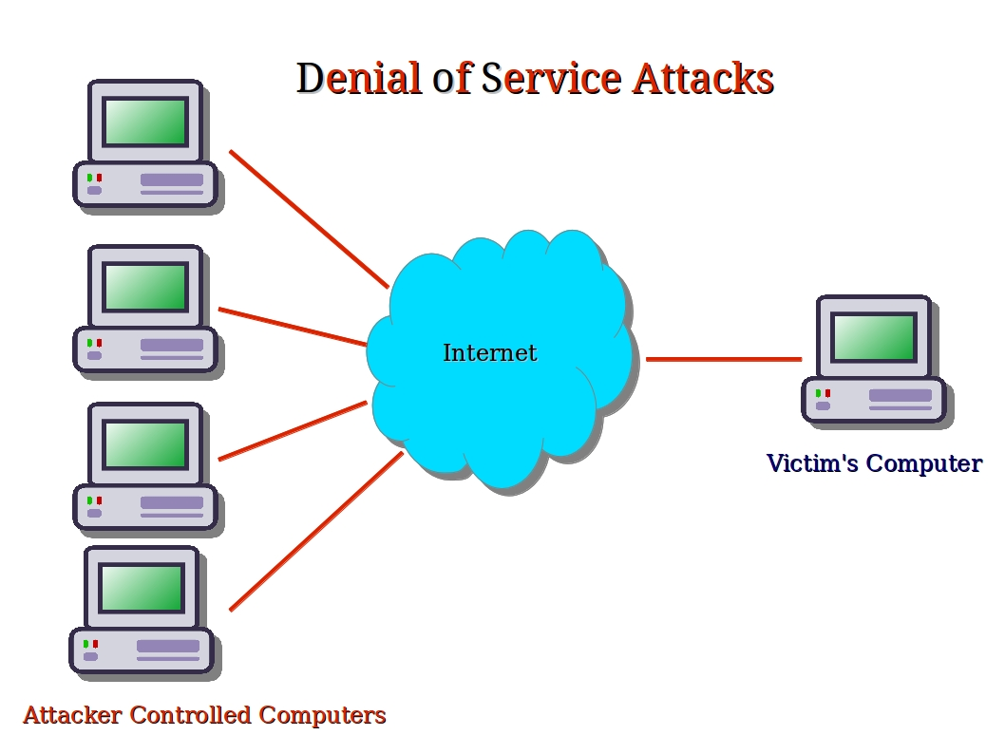
DoS Attacks
In a wireless environment, an attacker can attack a network from a distance and therefore, it is sometimes difficult to collect evidences against the attacker

Slide 6
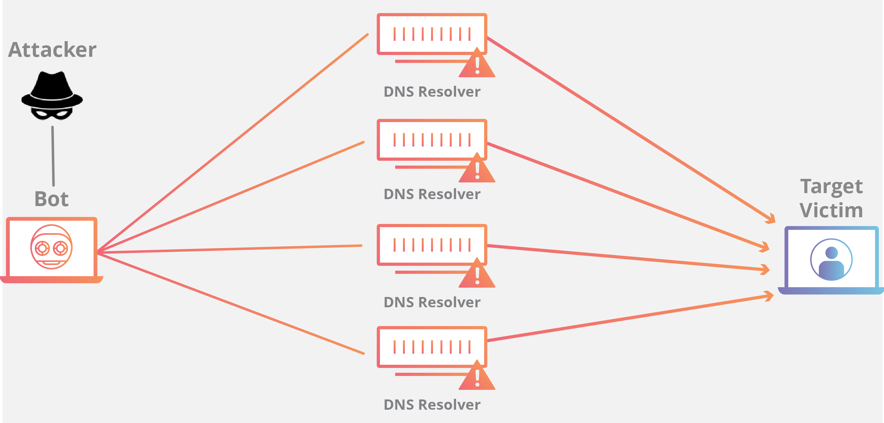
DDOS Attack
A Distributed Denial of Service

Slide 7
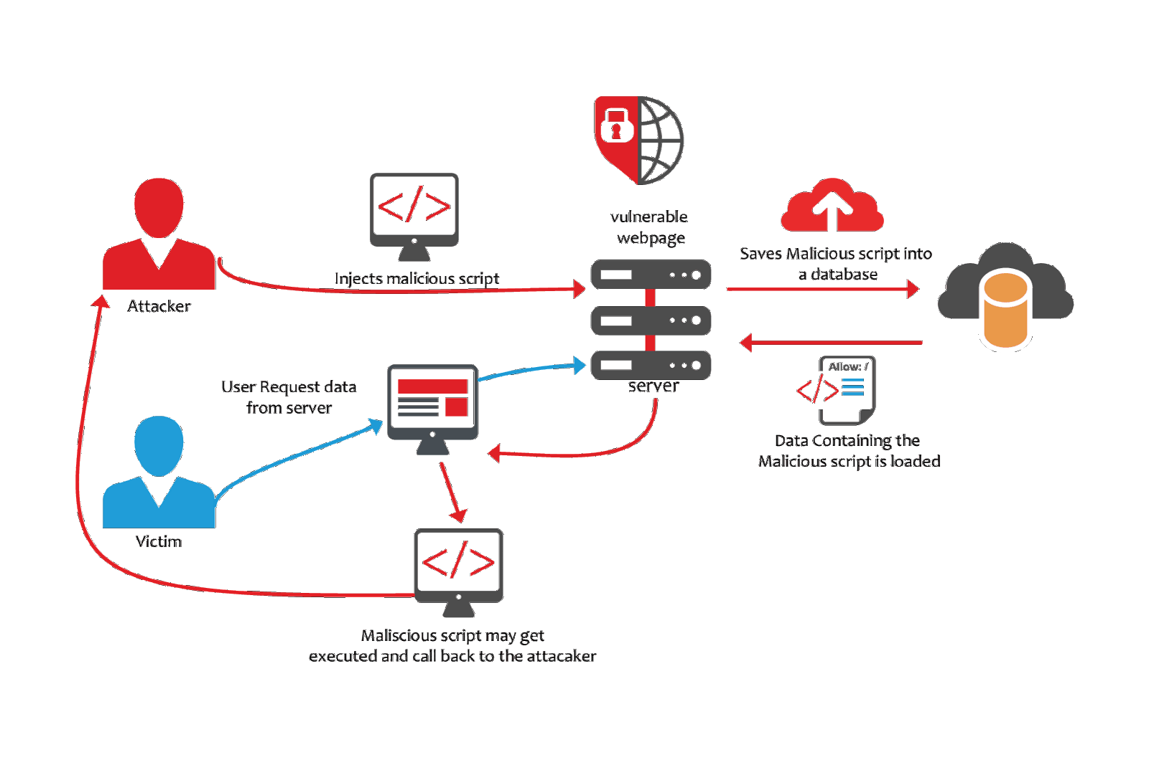
XSS
Cross-site scripting
(XSS) is a code injection attack

Slide 8
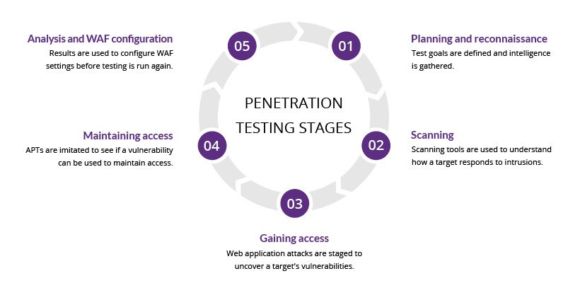
Penetration Testing

Slide 9
Thank You

